Slide 1


Spam or Not? Instagram Accounts Examined
Jamie Lynn Lufrano

Slide 2
About the Data Set
Source
Publicly available data set from Kraggle
696 Entries
12 attributes
Pre-Classified
“fake” == 0 (real) or “fake == 1 (fake)

Slide 3
Approach
Make observations on feature patterns based on means, standard deviations, and correlations
Test various classifiers based on groupings of features made from those observations, as well as all features (as a control)

Slide 4
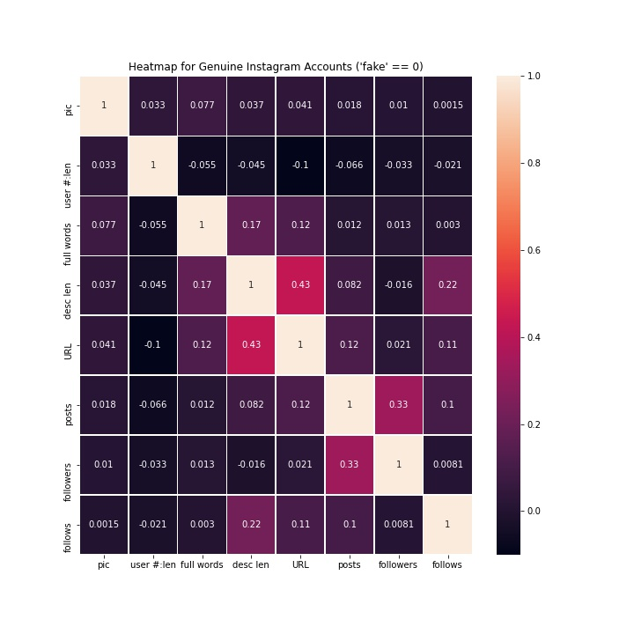
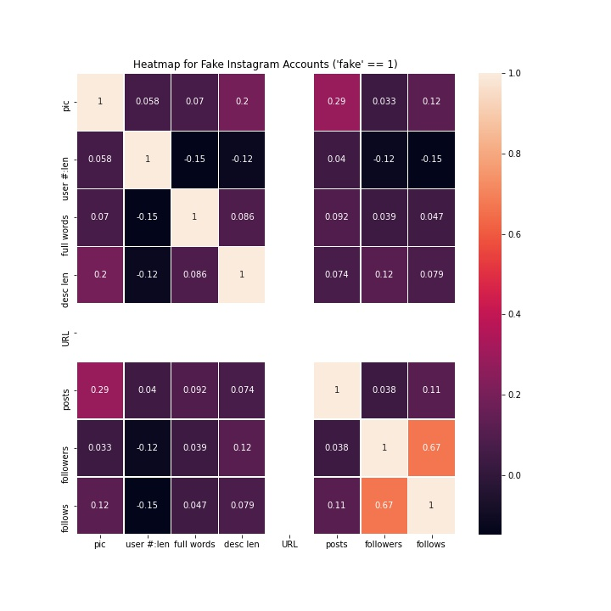
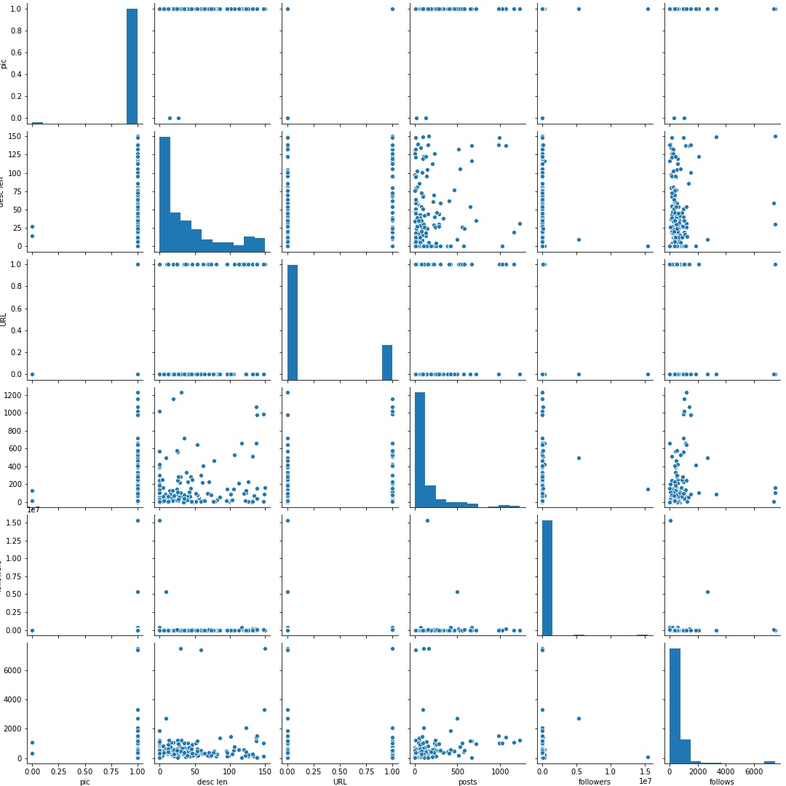
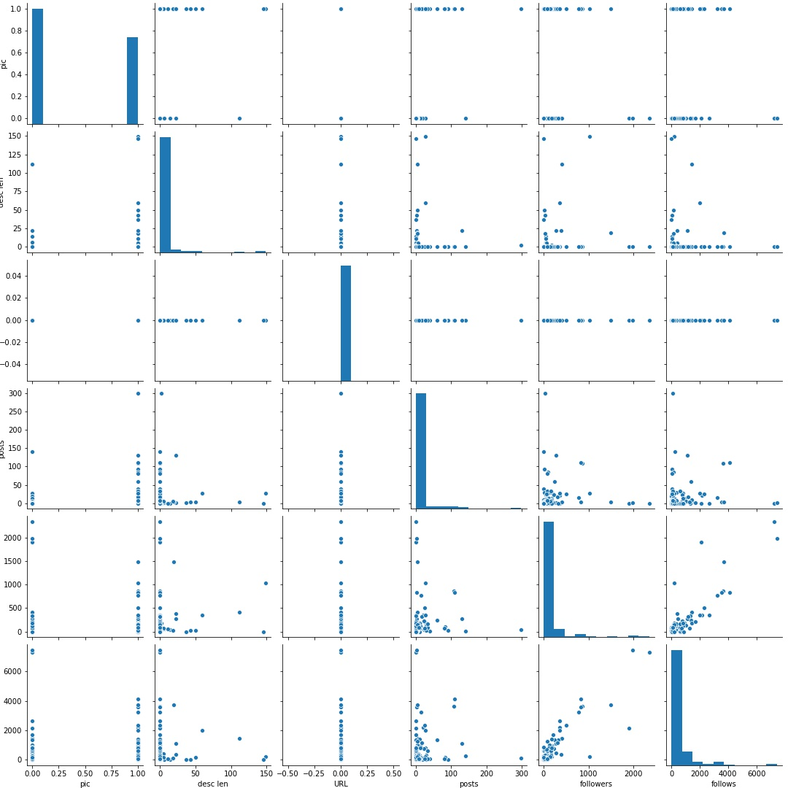
Examining the Features
"fake" | "fake" == 0 |  | "fake" == 1 |  | All
Feature | μ (0) | σ (0) | μ (1) | σ (1) | μ (All) | σ (All)
pic | 0.99 | 0.08 | 0.43 | 0.49 | 0.71 | 0.45
user #:len | 0.04 | 0.1 | 0.29 | 0.24 | 0.17 | 0.22
full words | 1.8 | 1.28 | 1.15 | 0.69 | 1.48 | 1.08
full #:len | 0.01 | 0.04 | 0.08 | 0.19 | 0.04 | 0.14
full=user | 0.01 | 0.08 | 0.07 | 0.25 | 0.04 | 0.19
desc len | 41.88 | 43.67 | 4.94 | 19.64 | 23.41 | 38.57
URL | 0.23 | 0.42 | 0 | 0 | 0.11 | 0.32
private | 0.43 | 0.5 | 0.3 | 0.46 | 0.37 | 0.48
posts | 197.92 | 516.51 | 8.57 | 26.3 | 103.24 | 377.76
followers | 158157.2 | 1185914 | 142.62 | 384.27 | 79149.91 | 842281.8
follows | 712.87 | 1073 | 397.3 | 944.16 | 555.09 | 1022.88
‘private’, ‘full=user’, and ‘full #:len’ were determined as least significant

Slide 5
Testing Classifiers
k-NN with k = 3
Logistic regression
Features | TP | FP | TN | FN | accuracy | TPR | TNR
all | 0 | 0 | 161 | 187 | 46.26% | 0.00% | 100.00%
reduced_features_1 | 0 | 0 | 161 | 187 | 46.26% | 0.00% | 100.00%
reduced_features_2 | 0 | 0 | 161 | 187 | 46.26% | 0.00% | 100.00%
reduced_features_3 | 0 | 0 | 161 | 187 | 46.26% | 0.00% | 100.00%
reduced_features_4 | 0 | 0 | 161 | 187 | 46.26% | 0.00% | 100.00%
reduced_features_5 | 1 | 0 | 161 | 186 | 46.55% | 0.53% | 100.00%
Features | TP | FP | TN | FN | accuracy | TPR | TNR
all | 9 | 0 | 172 | 167 | 52.01% | 5.11% | 100.00%
reduced_features_1 | 6 | 0 | 172 | 170 | 51.15% | 3.41% | 100.00%
reduced_features_2 | 0 | 0 | 172 | 176 | 49.43% | 0.00% | 100.00%
reduced_features_3 | 0 | 0 | 172 | 176 | 49.43% | 0.00% | 100.00%
reduced_features_4 | 0 | 0 | 172 | 176 | 49.43% | 0.00% | 100.00%
reduced_features_5 | 0 | 0 | 172 | 176 | 49.43% | 0.00% | 100.00%
“Toss a coin”

Slide 6
Testing Classifiers
Naive Bayesian
Features | TP | FP | TN | FN | accuracy | TPR | TNR
all | 156 | 87 | 85 | 20 | 69.25% | 88.64% | 49.42%
reduced_features_1 | 156 | 87 | 85 | 20 | 69.25% | 88.64% | 49.42%
reduced_features_2 | 156 | 87 | 85 | 20 | 69.25% | 88.64% | 49.42%
reduced_features_3 | 156 | 87 | 85 | 20 | 69.25% | 88.64% | 49.42%
reduced_features_4 | 161 | 101 | 71 | 15 | 66.67% | 91.48% | 41.28%
reduced_features_5 | 165 | 129 | 43 | 11 | 59.77% | 93.75% | 25.00%

Slide 7
Best Classifiers
Decision Tree
Decision Tree
Random Forest
Features | TP | FP | TN | FN | accuracy | TPR | TNR
all | 153 | 26 | 150 | 19 | 87.07% | 88.95% | 85.23%
reduced_features_1 | 158 | 25 | 151 | 14 | 88.79% | 91.86% | 85.80%
reduced_features_2 | 158 | 31 | 145 | 14 | 87.07% | 91.86% | 82.39%
reduced_features_3 | 148 | 33 | 143 | 24 | 83.62% | 86.05% | 81.25%
reduced_features_4 | 155 | 39 | 137 | 17 | 83.91% | 90.12% | 77.84%
reduced_features_5 | 145 | 32 | 144 | 27 | 83.05% | 84.30% | 81.82%
Features | (N, D) | TP | FP | TN | FN | accuracy | TPR | TNR
all | (7, 5) | 155 | 8 | 169 | 16 | 93.10% | 90.64% | 95.48%
reduced_features_1 | (9, 5) | 158 | 11 | 166 | 13 | 93.10% | 92.40% | 93.79%
reduced_features_2 | (4, 5) | 152 | 16 | 161 | 19 | 89.94% | 88.89% | 90.96%
reduced_features_3 | (6, 4) | 160 | 21 | 156 | 11 | 90.80% | 93.57% | 88.14%
reduced_features_4 | (4, 5) | 147 | 16 | 161 | 24 | 88.51% | 85.96% | 90.96%
reduced_features_5 | (3, 3) | 138 | 13 | 164 | 33 | 86.78% | 80.70% | 92.66%

Slide 8
Experimental Data
Random Forest
Features | (N, D) | TP | FP | TN | FN | accuracy | TPR | TNR
all | (1, 2) | 3 | 0 | 3 | 0 | 100.00% | 100.00% | 100.00%
reduced_features_1 | (3, 1) | 3 | 1 | 2 | 0 | 83.33% | 100.00% | 66.67%
reduced_features_2 | (8, 4) | 3 | 0 | 0 | 3 | 100.00% | 100.00% | 100.00%
reduced_features_3 | (7, 1) | 3 | 0 | 3 | 0 | 100.00% | 100.00% | 100.00%
reduced_features_4 | (2, 1) | 3 | 0 | 3 | 0 | 100.00% | 100.00% | 100.00%
reduced_features_5 | (3, 1) | 3 | 0 | 3 | 0 | 100.00% | 100.00% | 100.00%

Slide 9
Conclusion
Based on this data set, the smallest grouping of features that I would use to produce the most accurate results for classifying real and fake Instagram accounts would be: 'pic', 'user #:len', 'full words', 'desc len', 'URL', 'posts', 'followers', 'follows'.

